Slide 1

Case Study 2: Employee Attrition DS6306-Doing Data Science
Sophia Wu
08/2020
GitHub Repository: https://github.com/sophiawu1006/DDSProject2
Youtube link:https://www.youtube.com/watch?v=zjtrIXy60ko

Slide 2
3 TASKS
TASK Assigned:
Identify the top factors that contribute to turnover (backed up by evidence provided by analysis).
Task 2
Provide any job role specific trends that may exist in the data set, and any other interesting trends and observations from your analysis.(e.g., “Data Scientists have the highest job satisfaction”).
Task 3
Build a model to predict attrition and salary.
Task 1

Slide 3
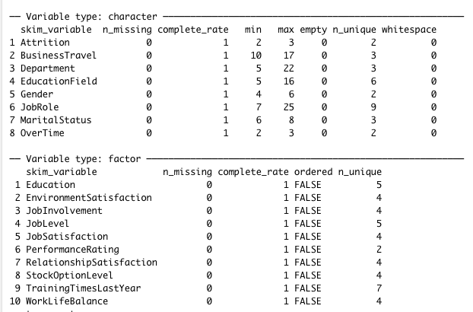
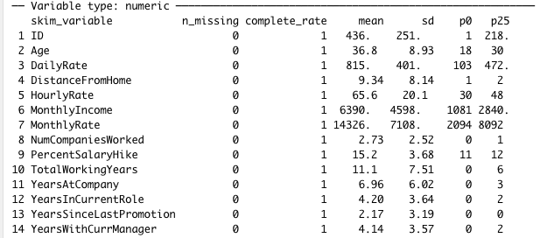
Data Summary
Observation: 870
Variables: 32
Character 8
Factor 10
Numeric: 14
No missing values

Slide 4
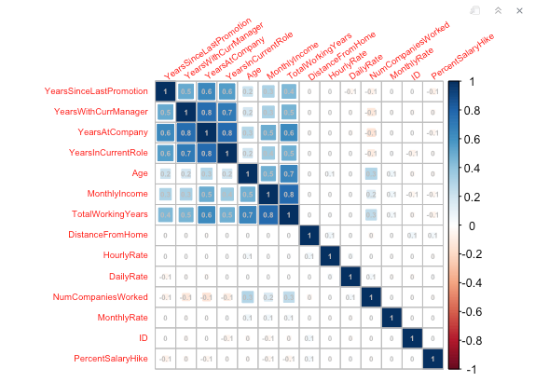
Correlation Check
Correlation Results (> 0.60)
0.8 TotalWorkingYears vs. MonthlyIncome
0.8 YearAtCompany vs. YearInCurrentRole
0.8 YearAtCompany vs. YearWithCurrManager
0.7 YearInCurrentRole vs. YearWithCurrManager
0.7 TotalWorkingYears vs. Age
0.6 YearAtCompany vs. TotalWorkingYears
0.6 YearAtCompany vs. YearsSinceLastPromotion

Slide 5
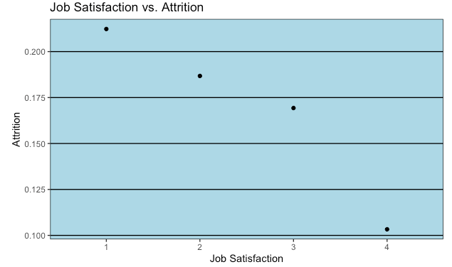
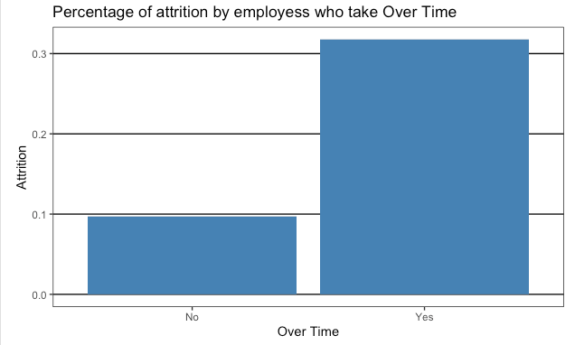
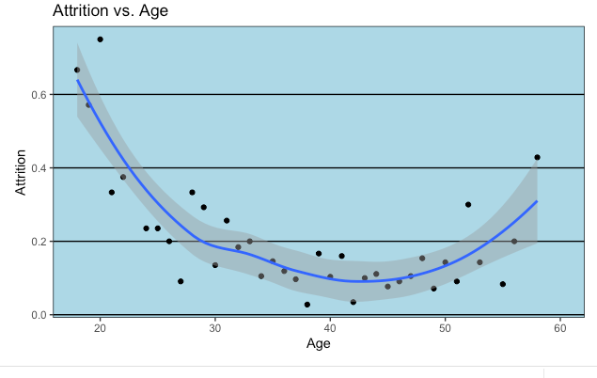
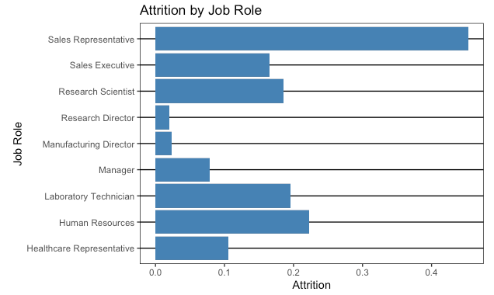
Top Factors for Attrition: JobSatisfaction, OverTime, Age ,Job Role

Slide 6

Attrition Prediction :
Naive Bayes Model
Top factors variables for Attrition:
Age
JobRole
JobSatisfaction
OverTime
Accuracy: 0.849387
Specificity: 0.8587652
Sensitivity: 0.6427007
Attrition Prediction :

Slide 7
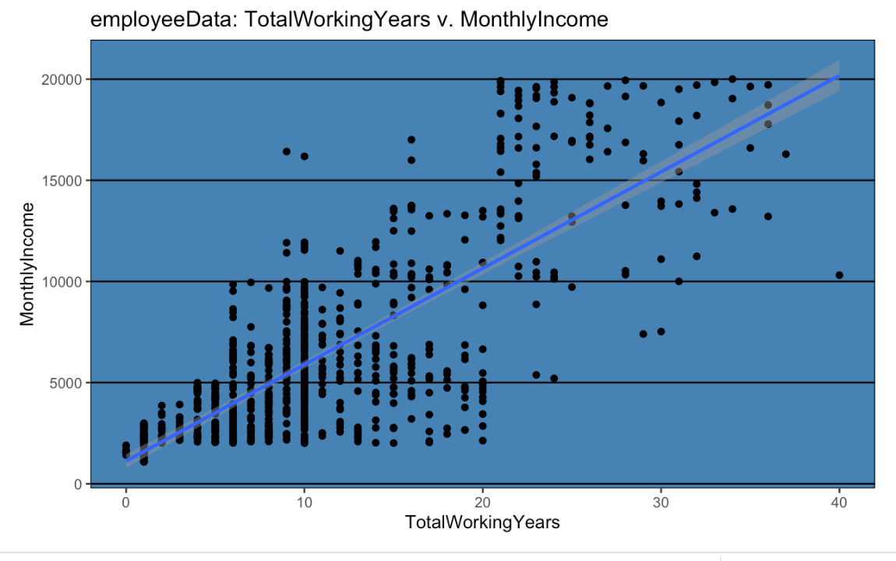
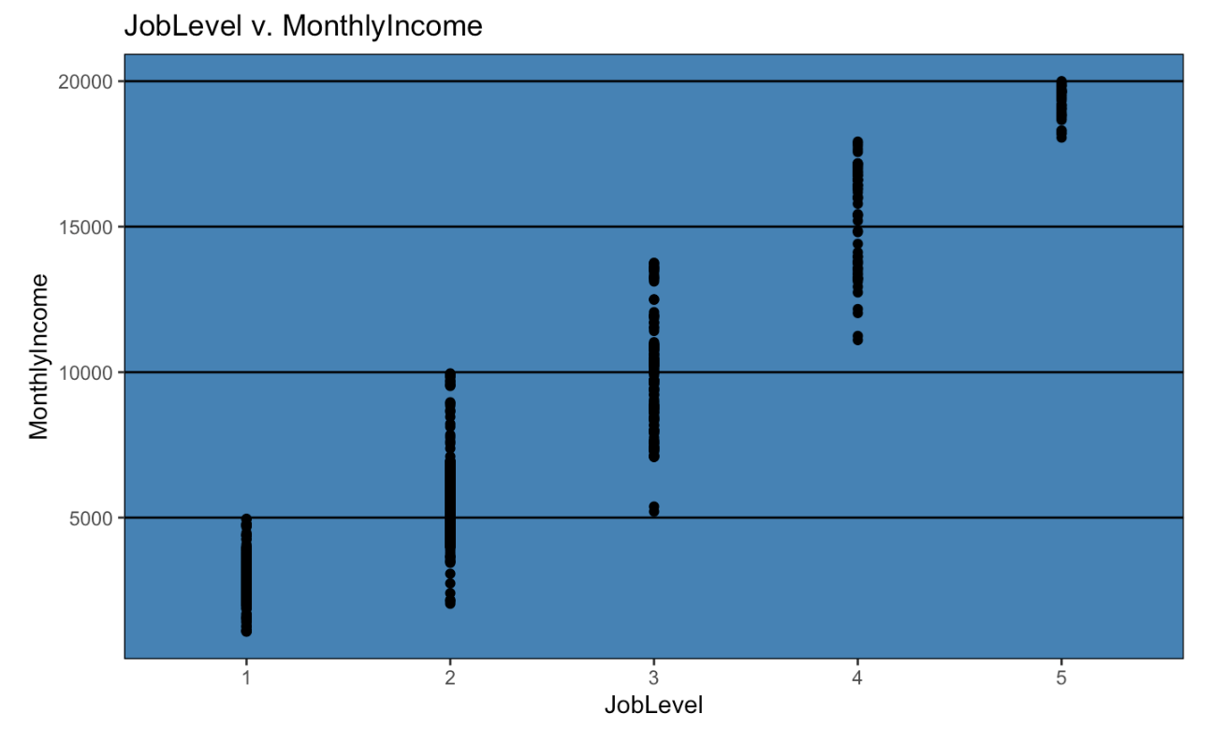
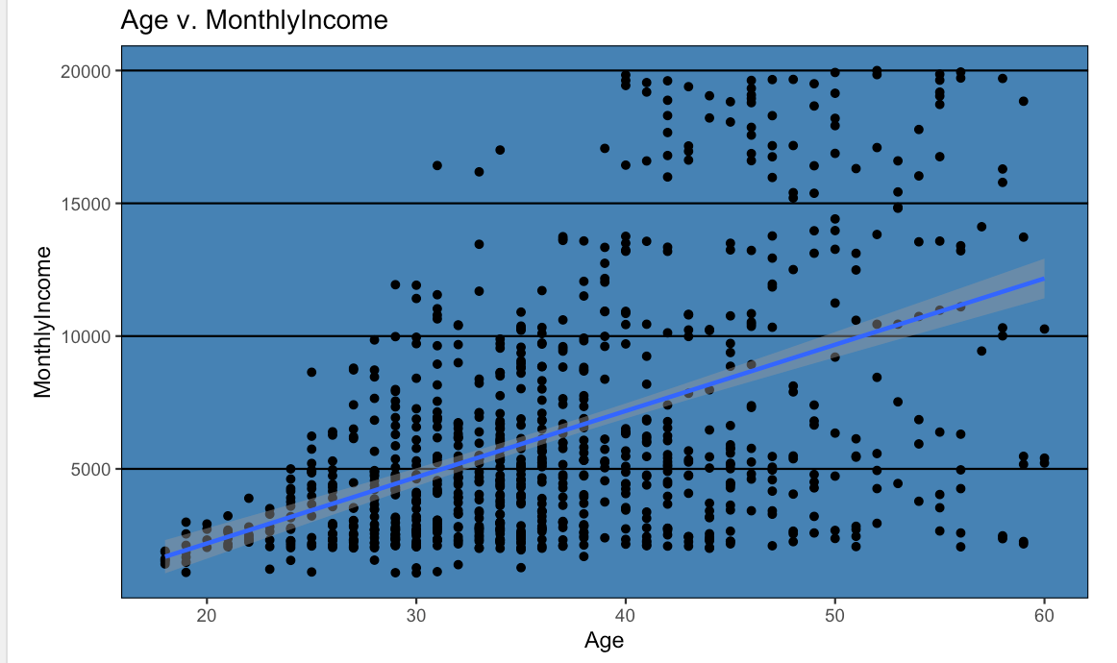
Top Factors for Salary:
MonthlyIncome vs. JobLevel
MonthlyIncome vs. TotalWorkingYears
MonthlyIncome vs. Age

Slide 8
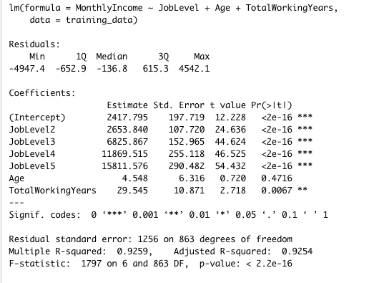
Salary Prediction:
RMSE:1203
Salary Prediction :

Slide 9

Conclusion:
Top factors for Attrition (Accuracy: 0.849387 ,Specificity: 0.8587652 and Sensitivity: 0.6427007 )
JobSatisfaction
OverTIme
Age
JobRole
Top factors for salary with RMSE 1203
Job level
Total Working years
Age

